Slide 1

CTI AML NK scRNAseq data analysis package
Yao Zhan
Computational Oncology_ RDI
Jan-16 -2024

Slide 2
Batch1 sequencing samples and associated metadata information
Date Received | sample | group | Viability_NC200 (%) | Estimated Recovery | Potential issue
2023-Dec | FN_lib1 | Fresh NK | 94.20% | 10000
2023-Dec | FT_lib2 | Fresh tumor | 94.90% | 10000 | compromised due to poor cell health
2023-Dec | BLN_lib3 | BL NK | too low to count accurately | 3522 | high red cell signal in cDNA BioA trace
2023-Dec | BMN_lib4 | BW NK | 91.80% | 8412 | low red cell signal in cDNA trace
2023-Dec | BLT_lib5 | BL tumor | 96.90% | 9478 | high red cell signal in cDNA BioA trace
2023-Dec | BMT_lib6 | BW tumor | 87.60% | 10000 | low red cell signal in cDNA trace

Slide 3
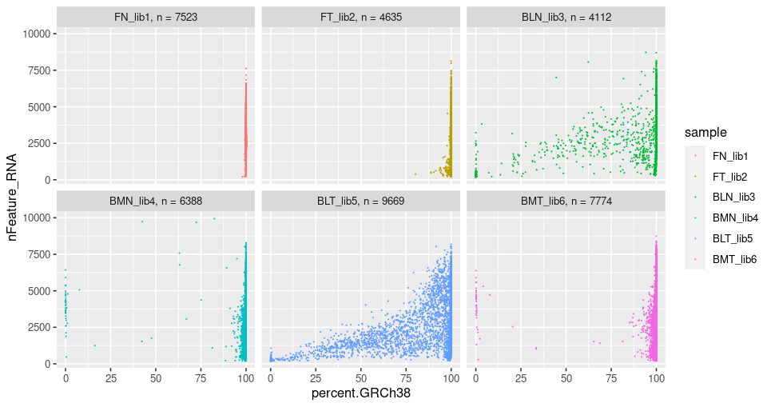
2 libraries showed species impurity: indicating contamination of mouse cells

Slide 4
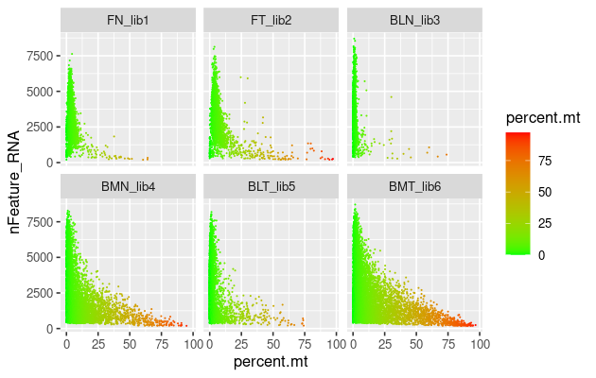
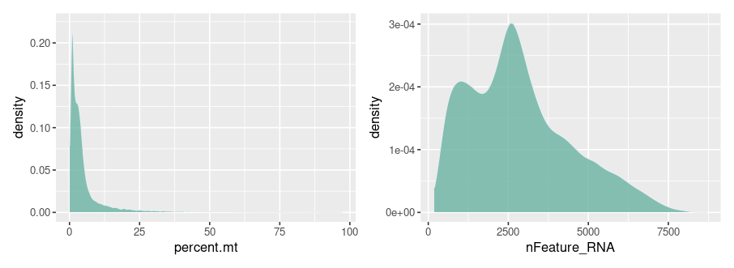
Most single cells showed low mitochondrial content in the libraries after filtering mouse cells

Slide 5
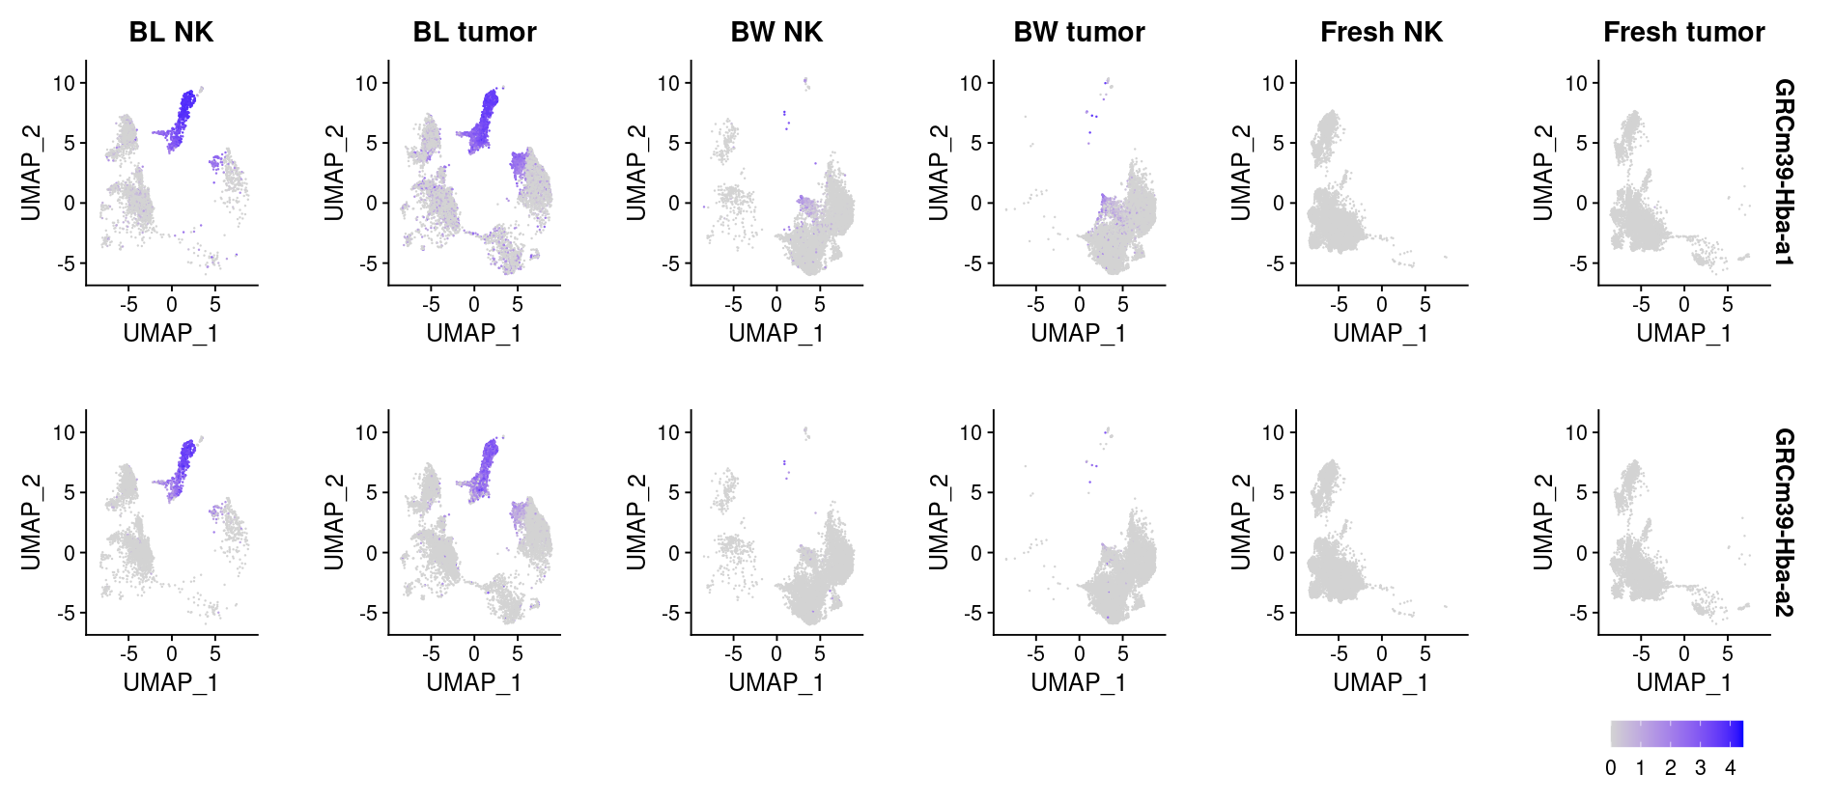
Mouse red blood cell contamination in blood NK and tumor samples

Slide 6
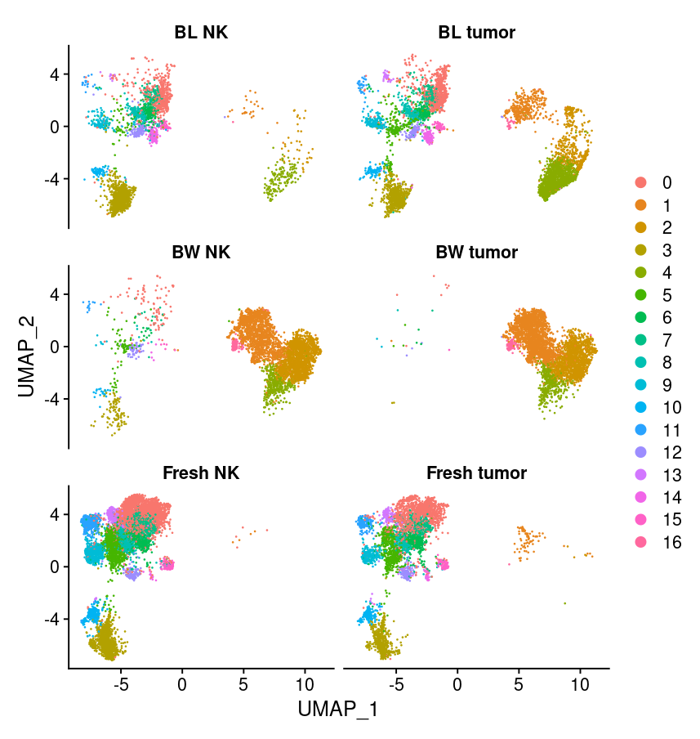
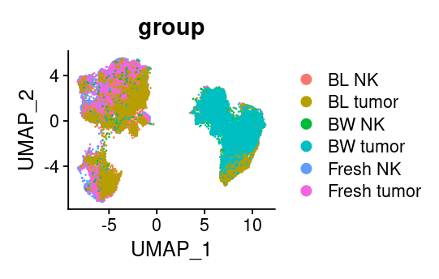
Fresh NK and tumor cells showed separation with D14 NK and tumor cells on UMAP spaces

Slide 7
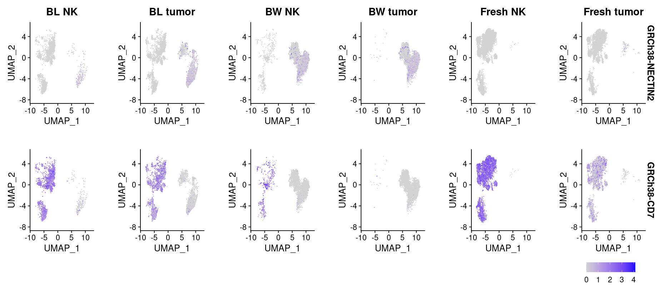
Marker expression in NK cells and AML cells
Analysis plan
NK and tumor cells showed colocalization, are they mixed?
Notes:
All mean values are average CAR or individual CAR

Slide 8
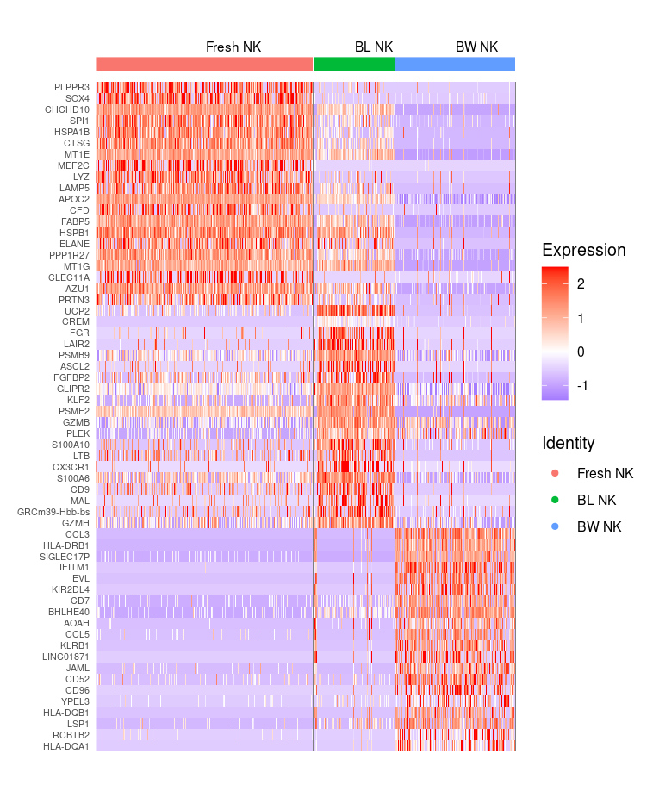
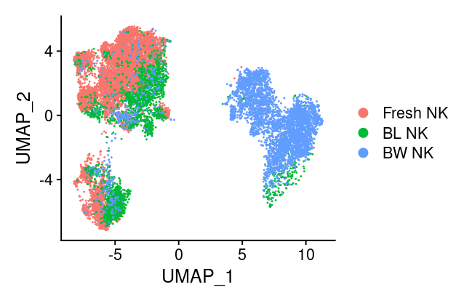
Unsupervised clustering in NK cells from D0-D14 to explore differential expressed genes
NK and tumor cells showed colocalization, are they mixed?
Notes:
All mean values are average CAR or individual CAR

Slide 9
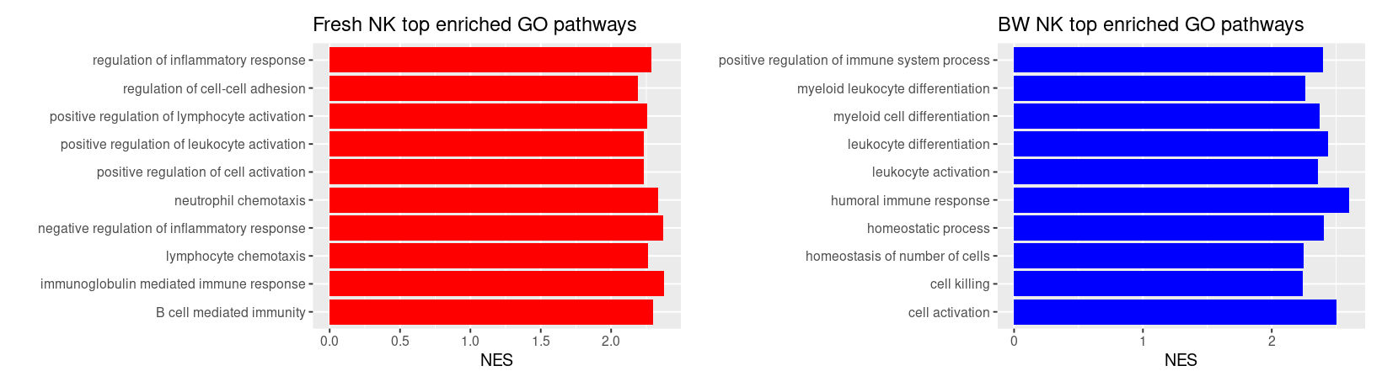
Fresh NK and BW NK showed differential enriched GO pathways
Fresh NK cells upregulated lymphocyte activation/adhesion/chemotaxis
Bone marrow NK showed leukocyte differentiation pathway activation

Slide 10
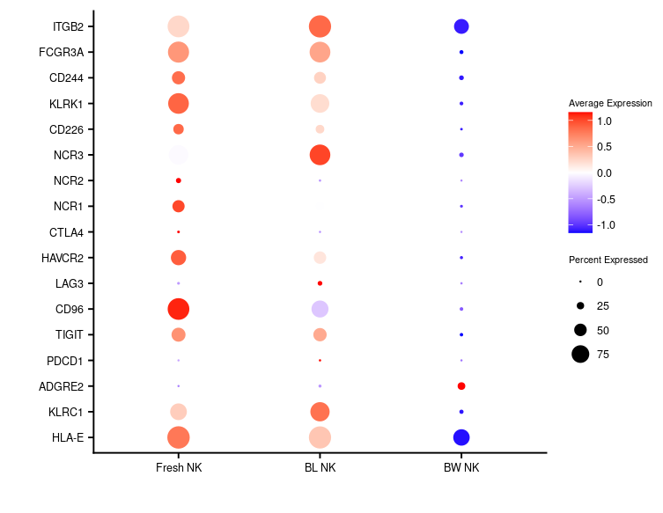
Exploring the expression NK cell activating and inhibitory receptors in NK samples
NK activation
NK Inhibitory
NK activation receptor expression was downregulated in BW NK cells

Slide 11
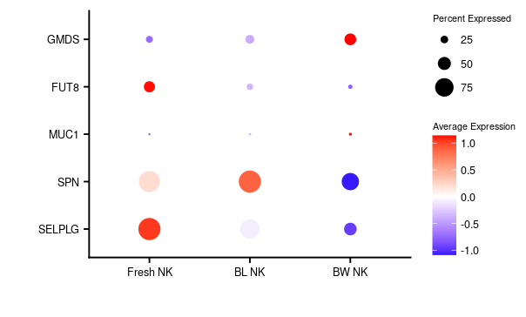
Exploring the expression NK resistance genes in NK samples (PMID: 38091953)
NK resistance gene list is from the paper:
Single-cell functional genomics reveals determinants of sensitivity and resistance to natural killer cells in blood cancers (suggested by Cici)
GMDS is moderately upregulated in BW NK compared with Fresh NK

Slide 12
CTI AML NK scRNAseq data analysis package: Batch1 + Batch2
Yao Zhan
Computational Oncology_ RDI
Feb-2 -2024

Slide 13
Batch1 sequencing samples and associated metadata information
Date Received | sample | group | Viability_NC200 (%) | Estimated Recovery | Potential issue
2023-Dec | FN_lib1 | Fresh NK | 94.20% | 10000
2023-Dec | FT_lib2 | Fresh tumor | 94.90% | 10000 | compromised due to poor cell health
2023-Dec | BLN_lib3 | BL NK | too low to count accurately | 3522 | high red cell signal in cDNA BioA trace
2023-Dec | BMN_lib4 | BW NK | 91.80% | 8412 | low red cell signal in cDNA trace
2023-Dec | BLT_lib5 | BL tumor | 96.90% | 9478 | high red cell signal in cDNA BioA trace
2023-Dec | BMT_lib6 | BW tumor | 87.60% | 10000 | low red cell signal in cDNA trace

Slide 14
Batch2 sample metadata
Date Received | Sample ID | Sample Description | Viability_NC200 (%) | Estimated Recovery | Potential issue | Sequencing and data analysis status
Jan/17/ 2024 | FT_lib1 | Fresh tumor |  | 10000 |  | Sequenced
Jan/17/ 2024 | BLT_lib2 | BL tumor_ tumor only |  | 10000 |  | Sequenced
Jan/17/ 2024 | BMT_lib3 | BW tumor_ tumor only |  | 4812 | may not accurate loading # due to low cell # counting | Sequenced

Slide 15
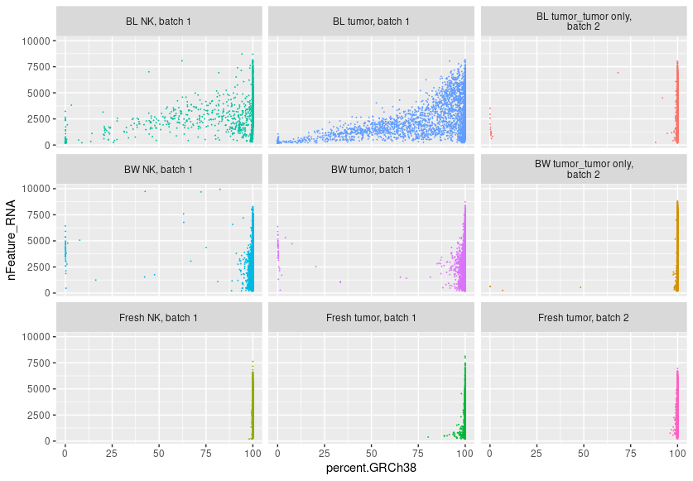
3 libraries from batch2 showed purity of human cells indicating no mouse cell contamination

Slide 16
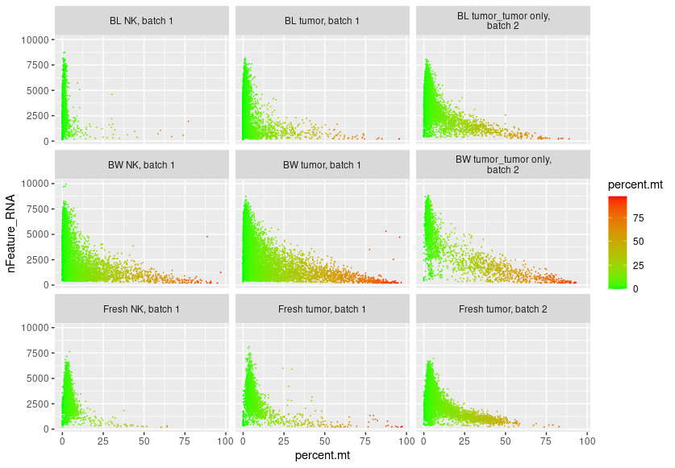
Most single cells showed low mitochondrial content in the libraries after filtering mouse cells

Slide 17
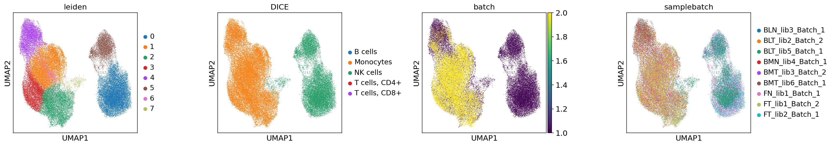
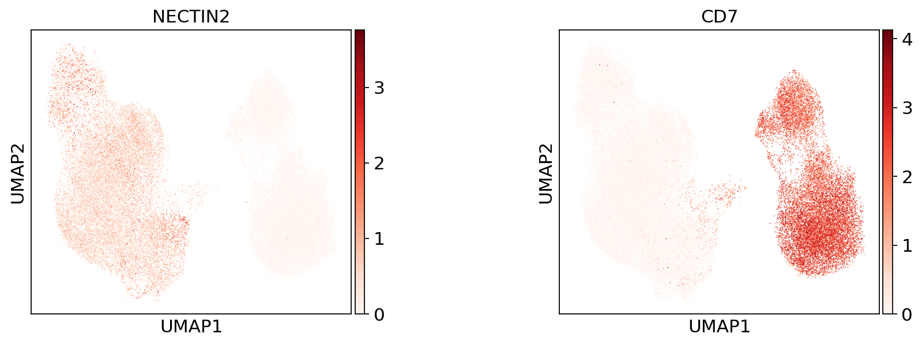
Unsupervised clustering in AML and NK cells from D0-D14 showed clear separation based on cell identity

Slide 18
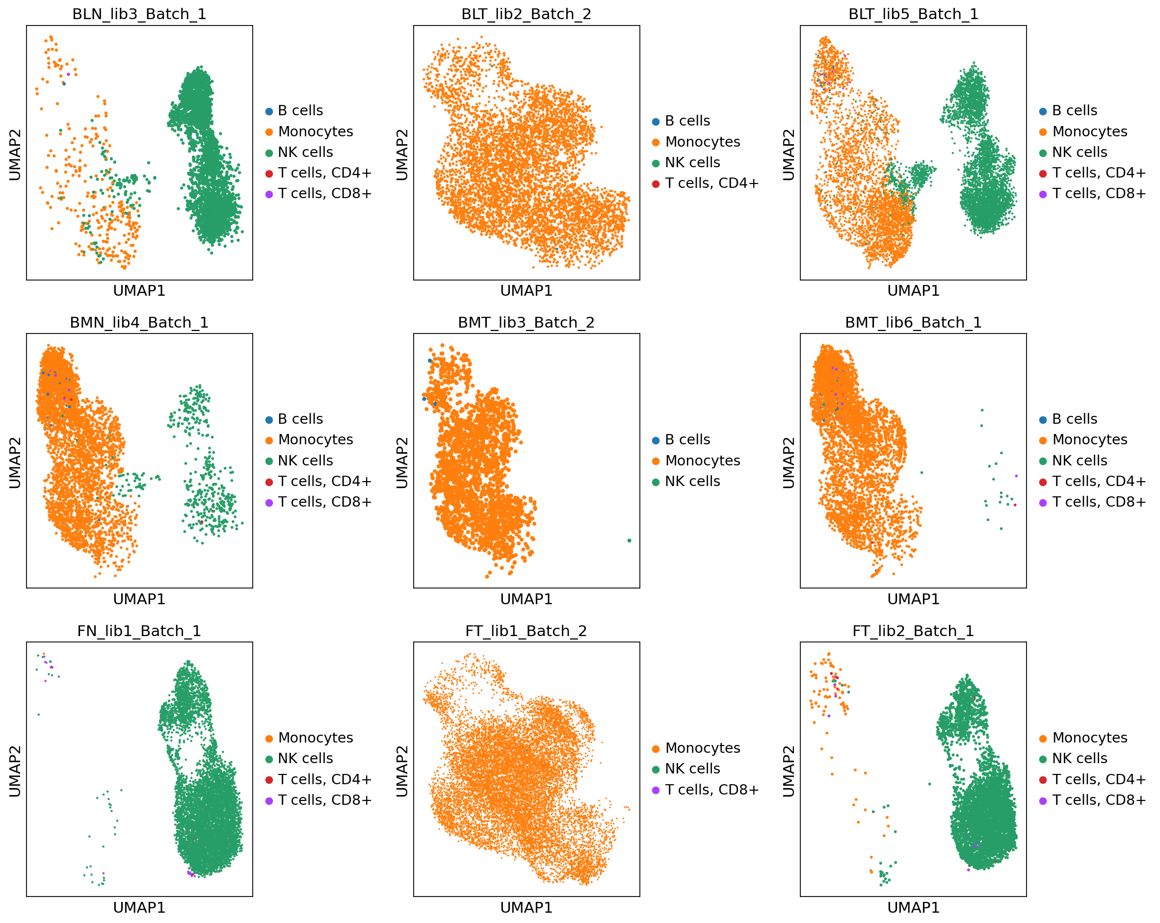
Batch2 tumor samples showed clear separation with NK samples, indicating batter sample purity than batch 1 tumor samples

Slide 19
Batch2 tumor samples showed clear separation with NK samples, indicating batter sample purity than batch 1 tumor samples
Please see my comment
Please see my comment

Slide 21
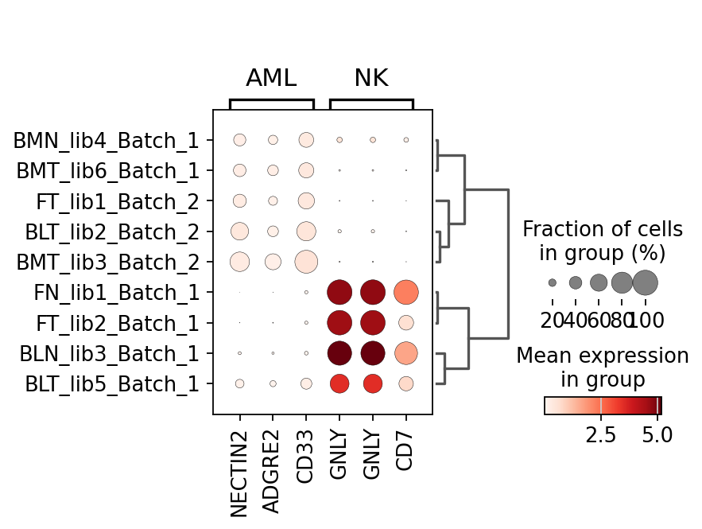
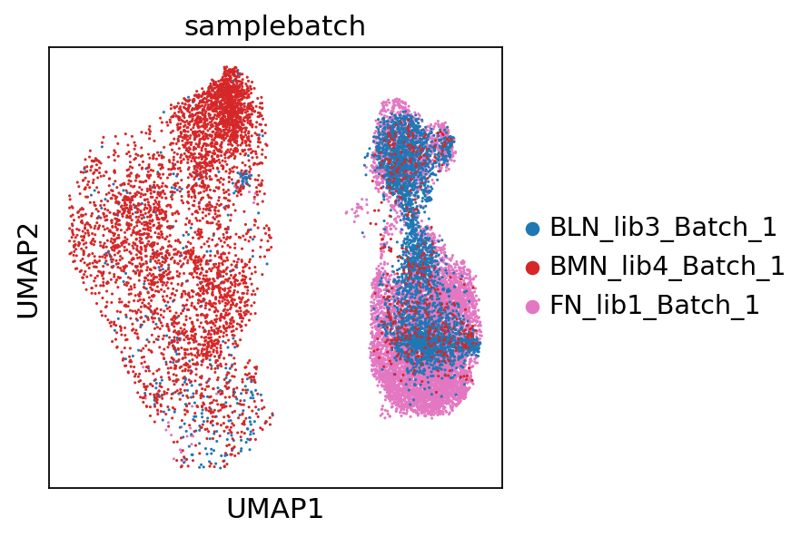
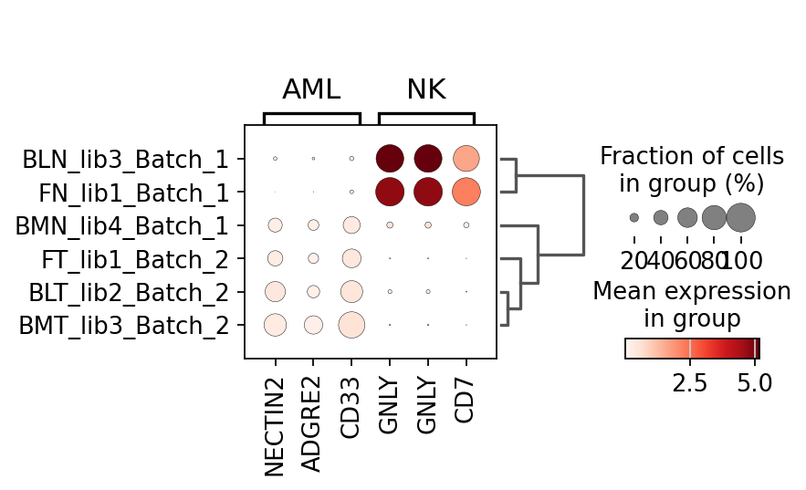
Batch1 NK samples still showed contamination of AML cells, indicating lower purity especially in Bone Marrow NK sample

Slide 22

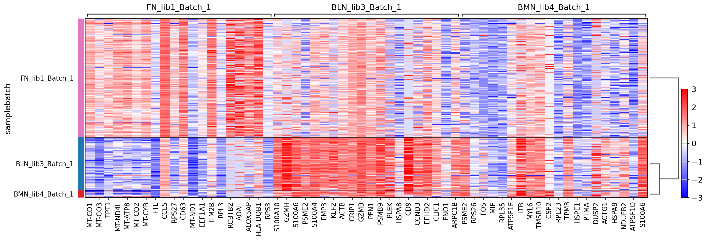
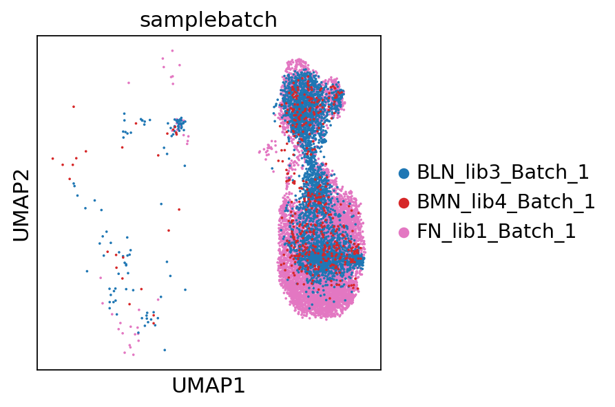
Unsupervised clustering in NK cells from D0-D14 showed differential expressed genes in blood and bone marrow NK cells than fresh NK
NK and tumor cells showed colocalization, are they mixed?
Notes:
All mean values are average CAR or individual CAR

Slide 23
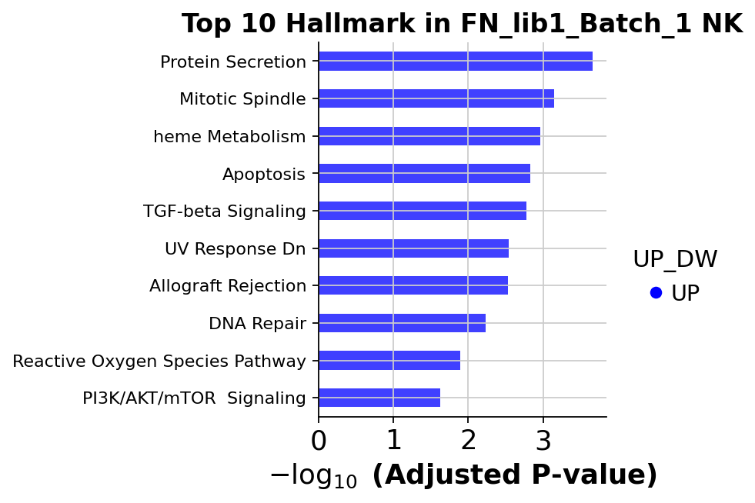
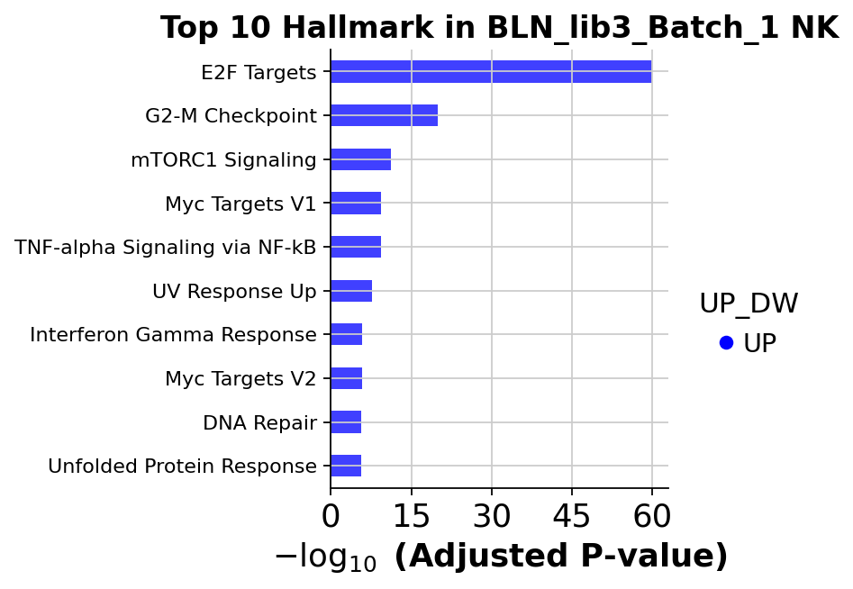
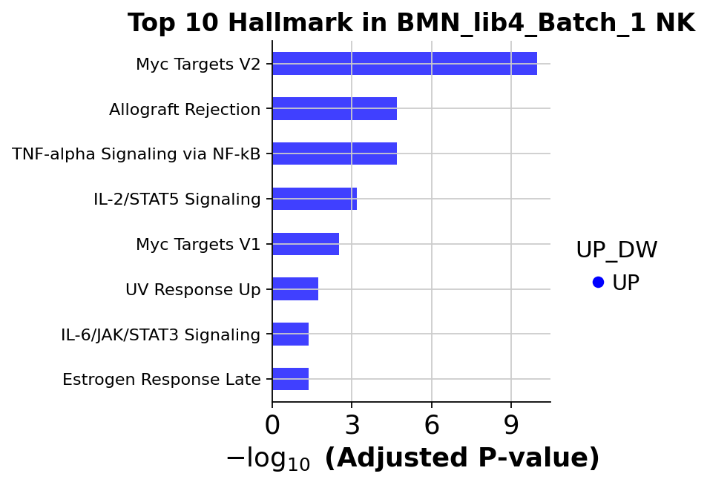
Fresh NK cells over express hallmark pathways associated with immune function, proliferation and metabolic activities(OXPHOS)

Slide 24
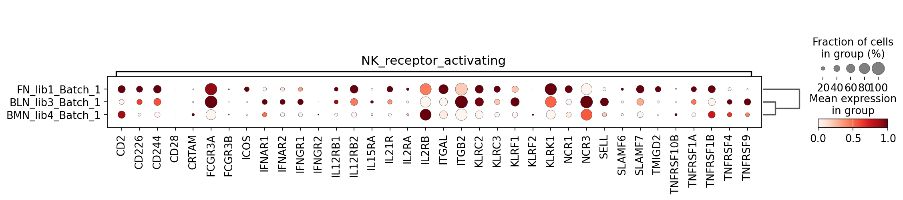
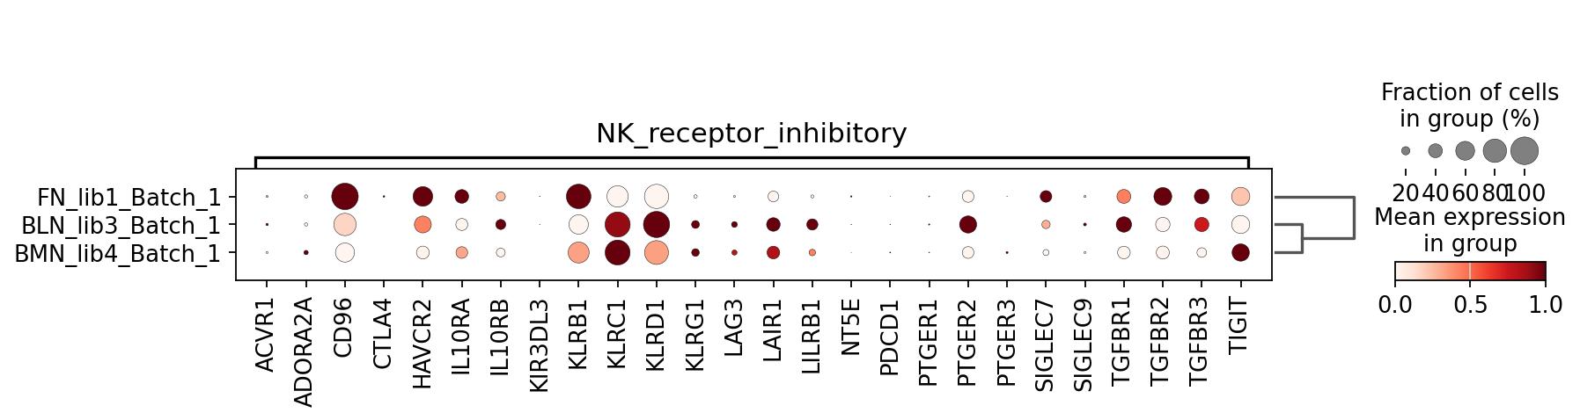
NK functional receptor expression profiles shifted largely between fresh VS post infusion NK cells

Slide 25
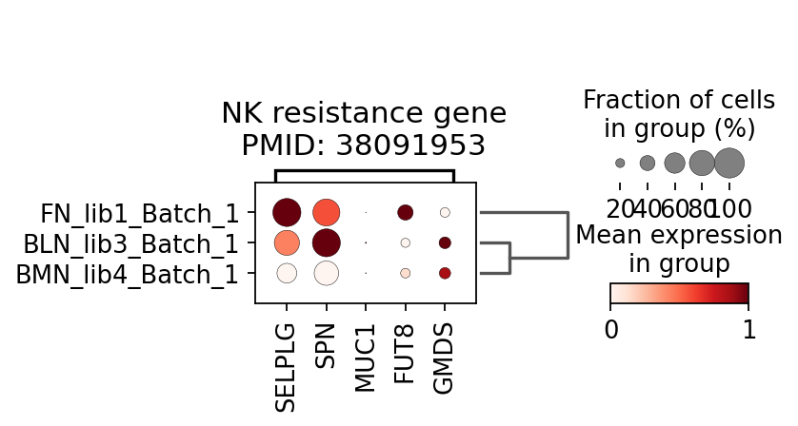
GMDS (NK resistance genes) expression is elevated in bone marrow NK sample (PMID: 38091953)

Slide 26
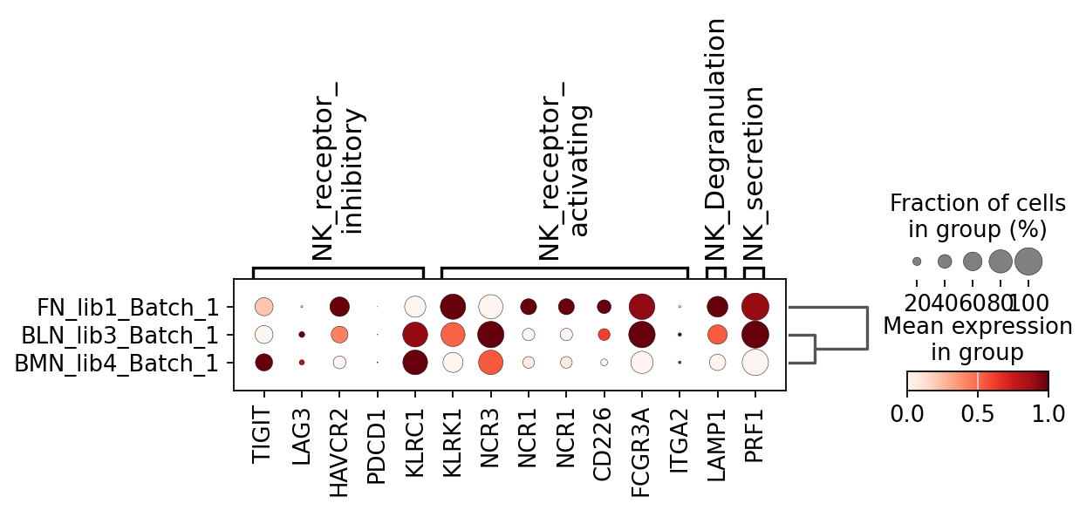
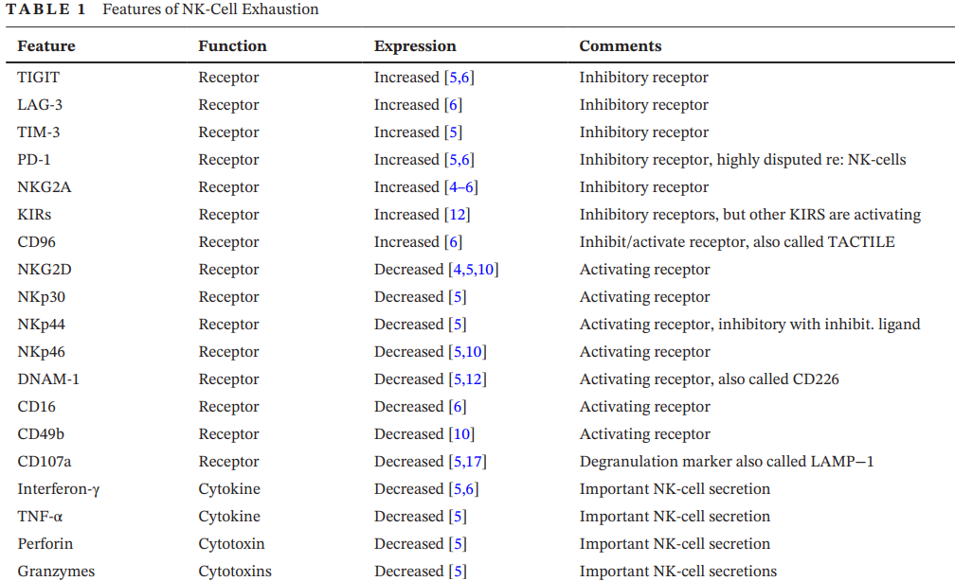
NK exhaustion marker expression profiles shifted largely between fresh VS post infusion NK cells
NK-cell exhaustion, B-cell exhaustion and T-cell exhaustion-the differences and similarities
Immunology 2022 Jun;166(2):155-168.
PMID: 35266556

Slide 27
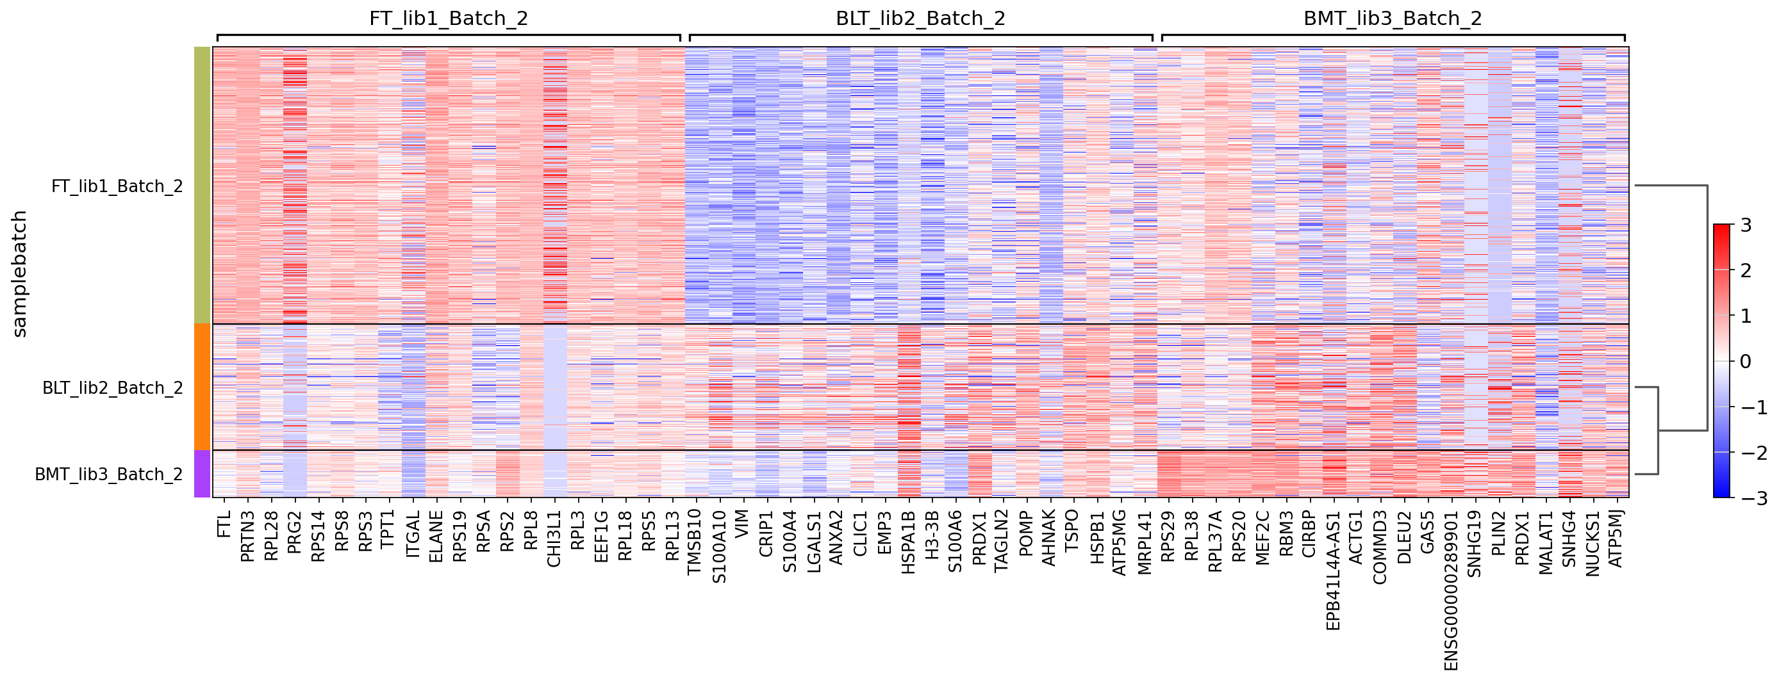
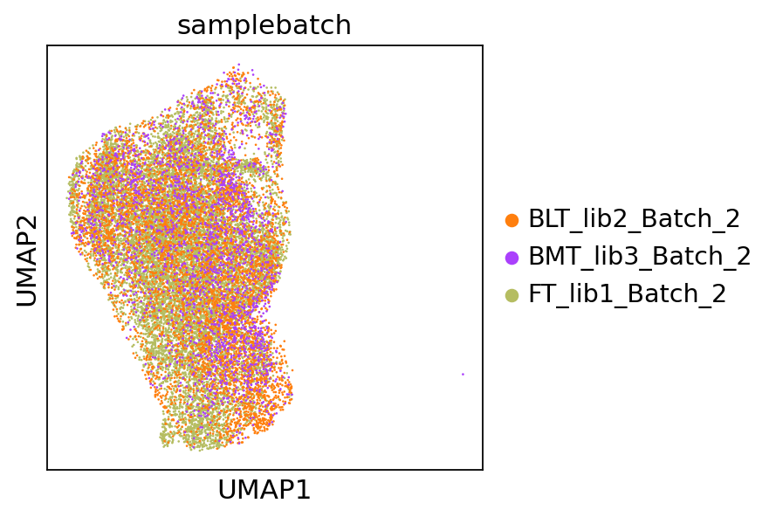
Unsupervised clustering in tumor cells from D0-D14 showed differential expressed genes in blood and bone marrow tumor cells than fresh tumor
Notes:
All mean values are average CAR or individual CAR

Slide 28
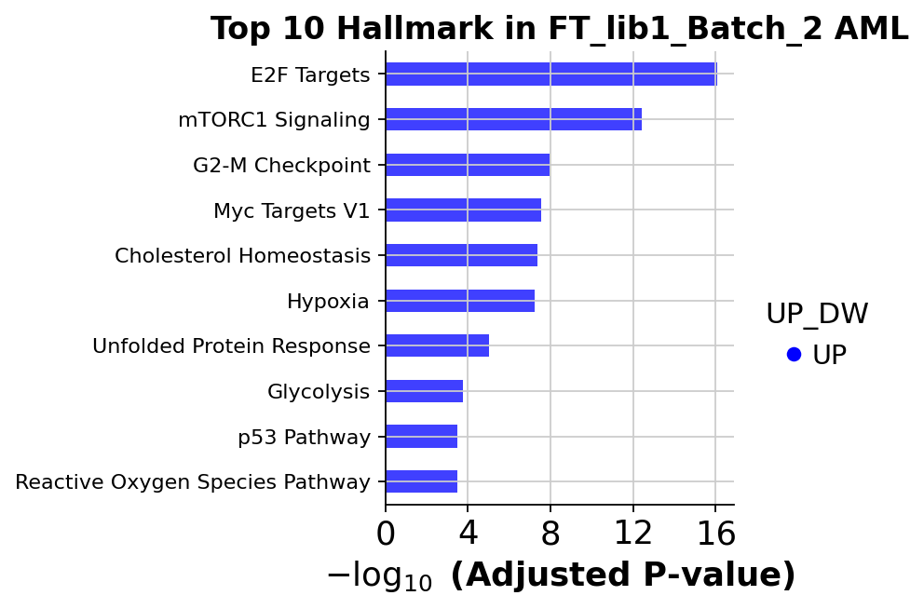
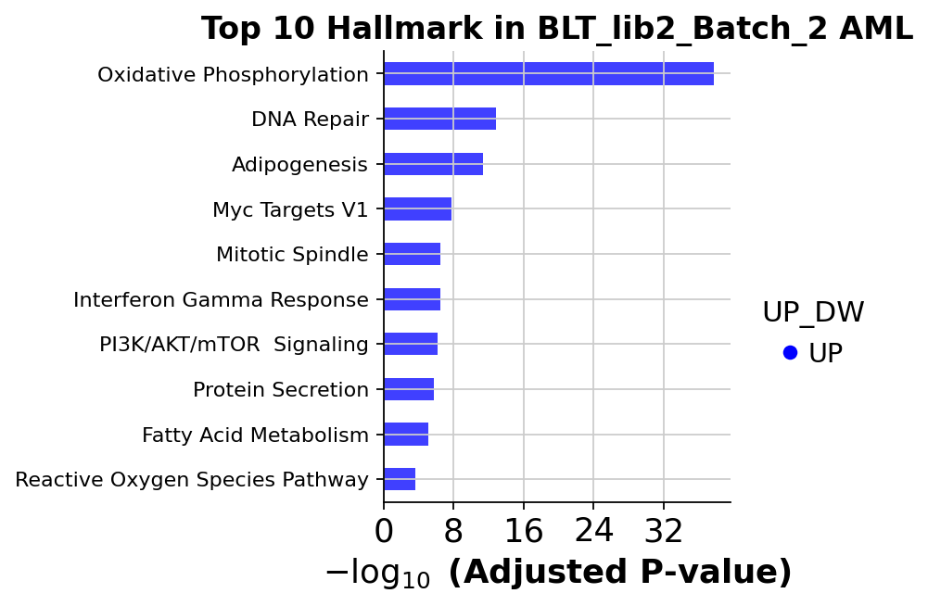
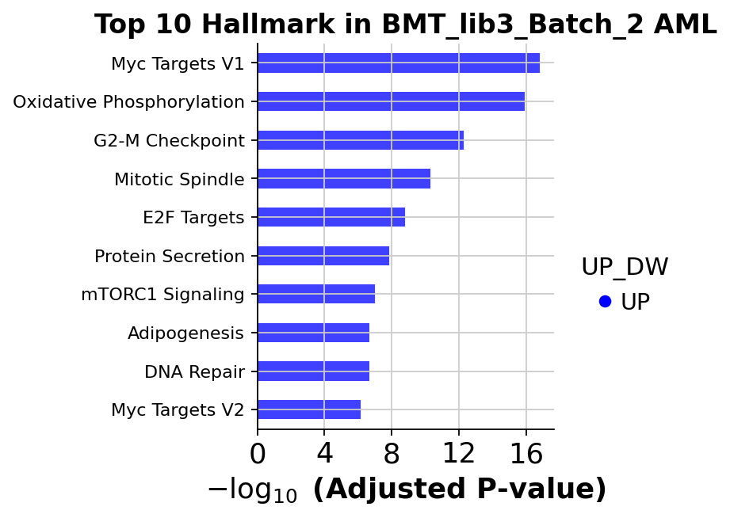
Bone marrow and blood AML cells over-express pathways associated with proliferation and metabolism

Slide 29
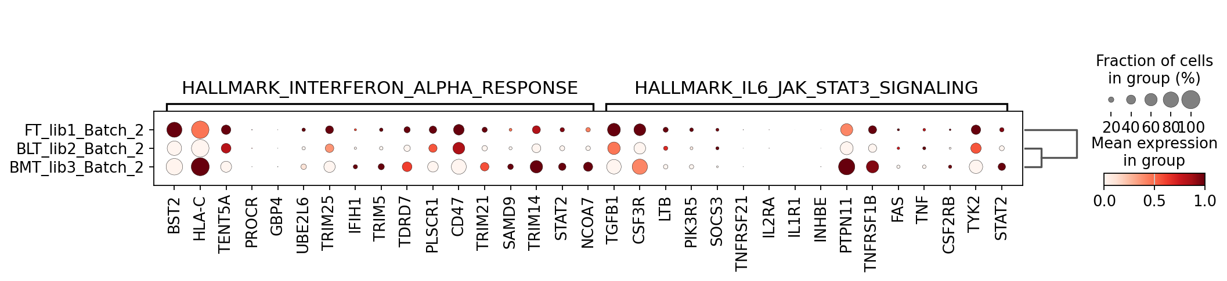
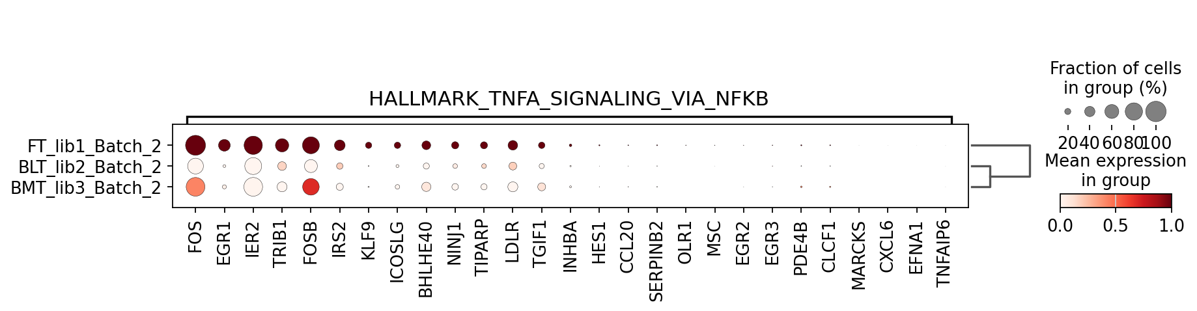
Fresh AML tumors activated pathways associated with IFNA, JAK-STAT and TNFA

Slide 30
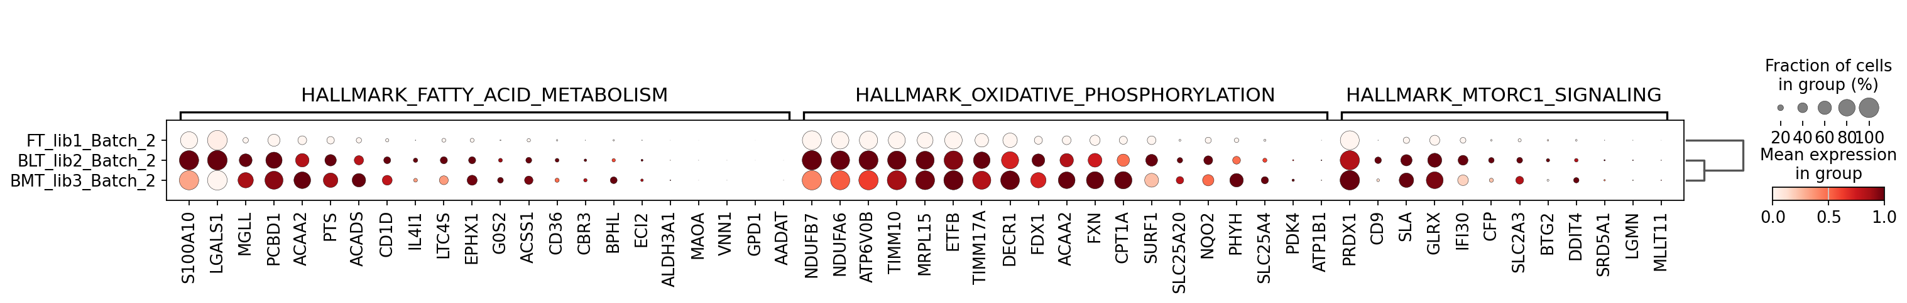
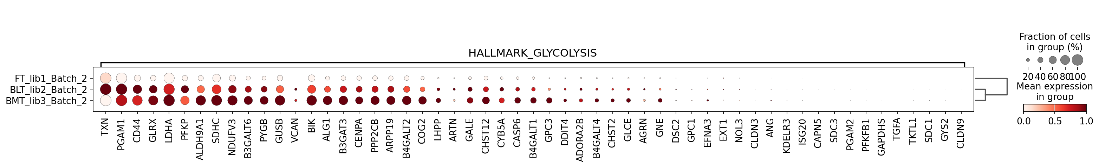
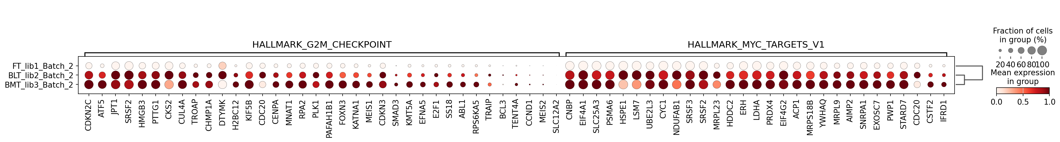
Bone marrow and blood AML tumors activated pathways in OXPHOS, Glycolysis, Myc and matabolism

Slide 31
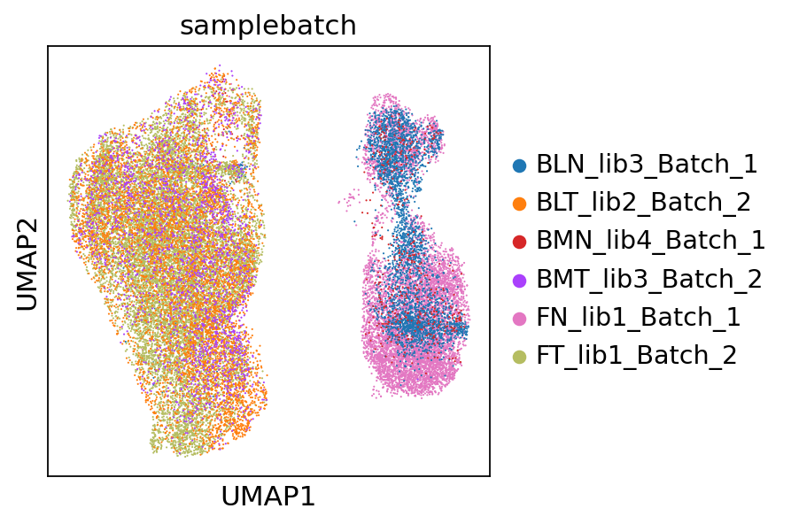
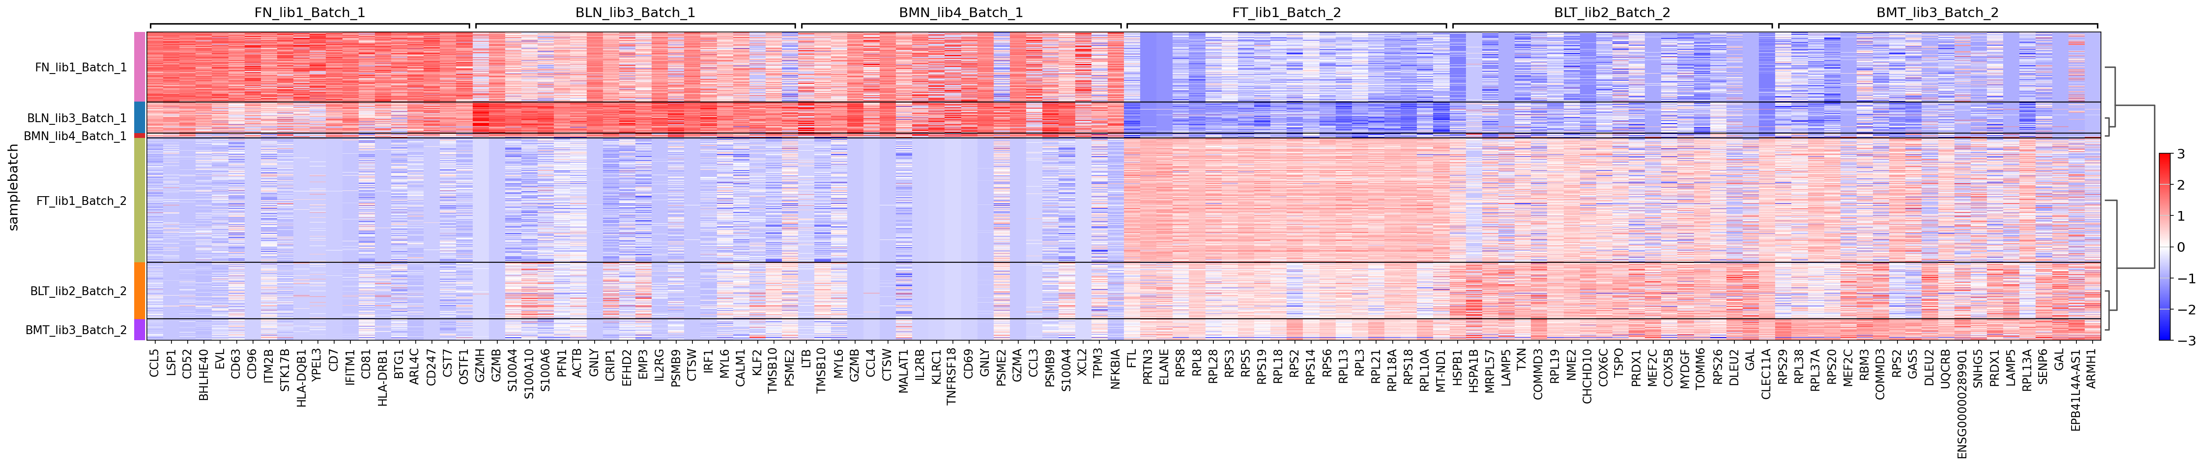
Differential expression profiles between NK samples and AML samples

Slide 32
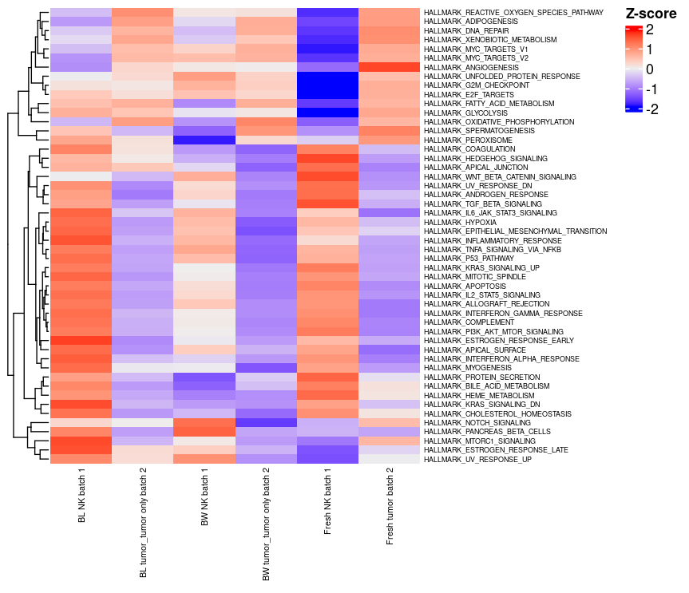
AML tumor samples showed higher metabolism activates than NK samples resulted in loss of metabolic fitness in NK cells that could be partly overcome

Slide 33
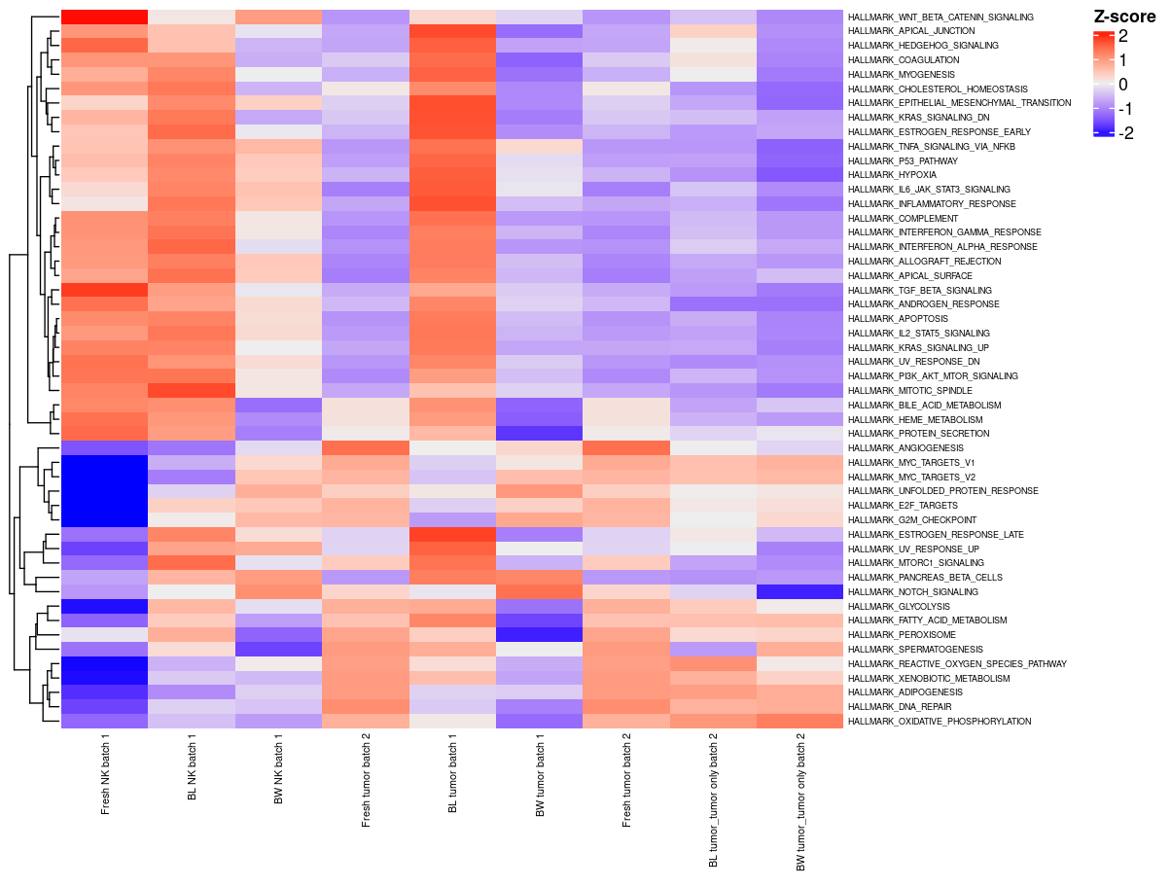
Using R processed data,
Without DICE filtering

Slide 34
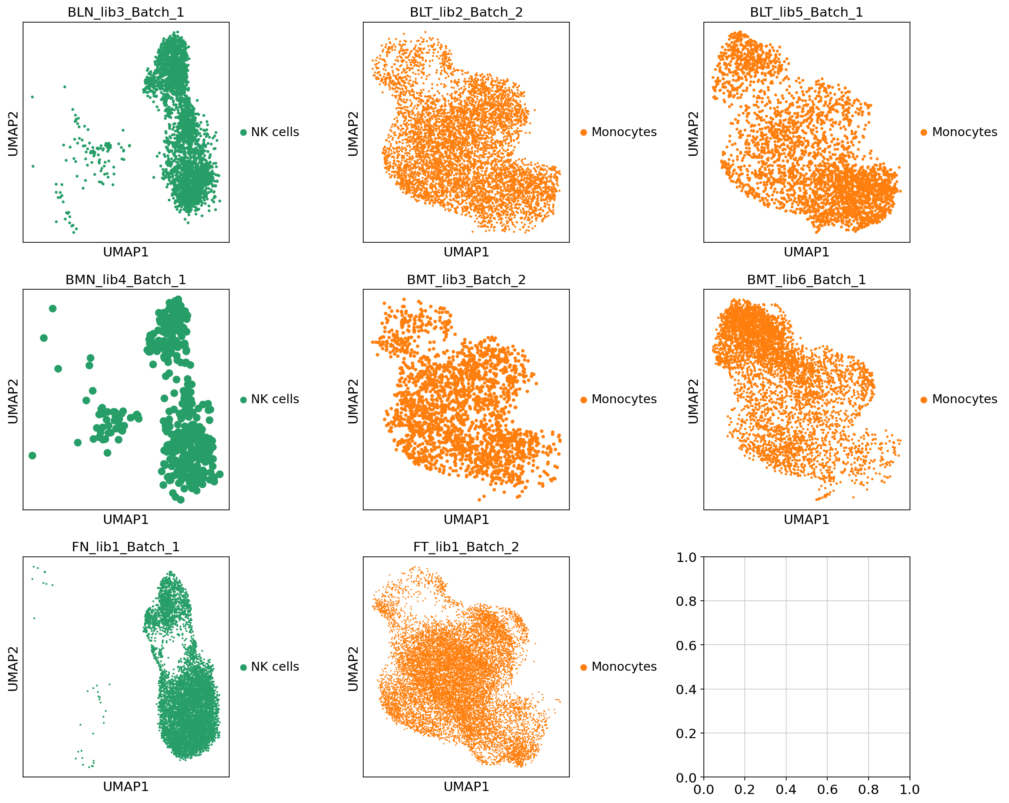

Slide 35
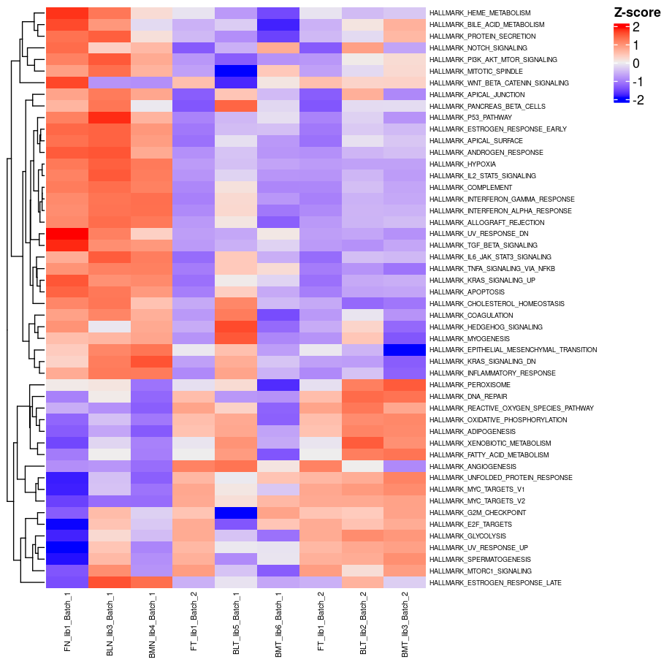
Using Python processed data,
With DICE filtering to get
Desired cell identities per sample

Slide 36
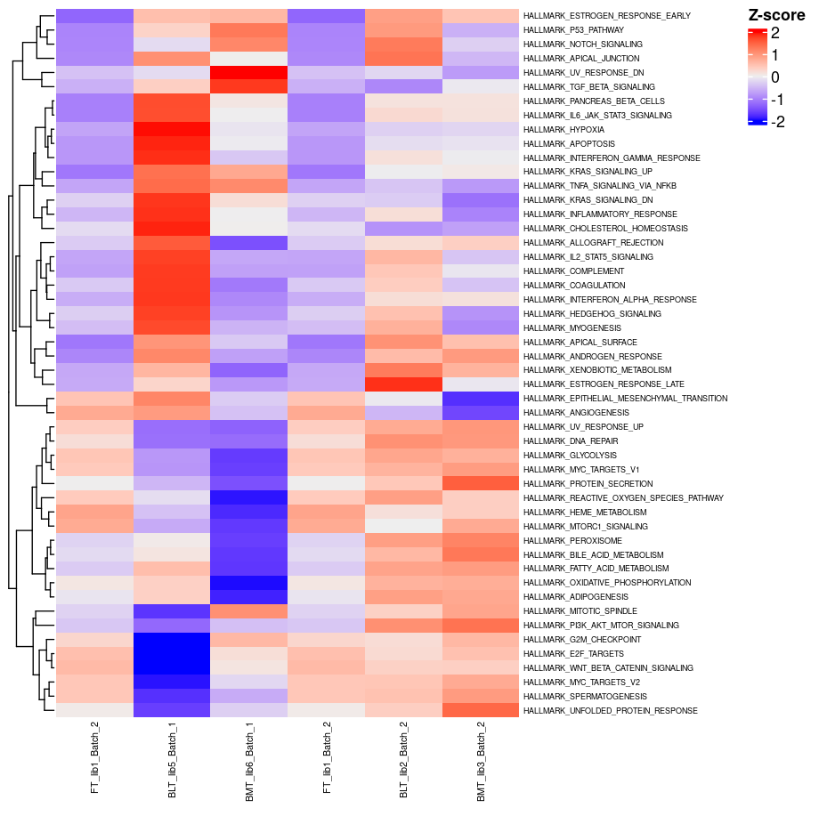

Slide 37
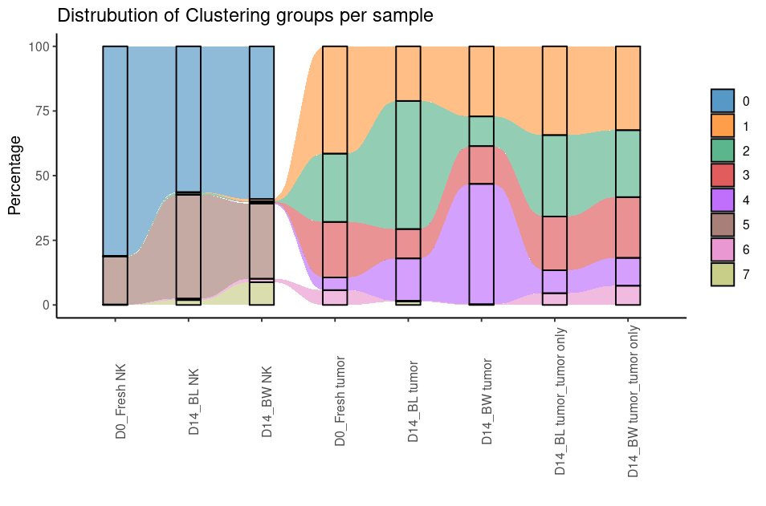
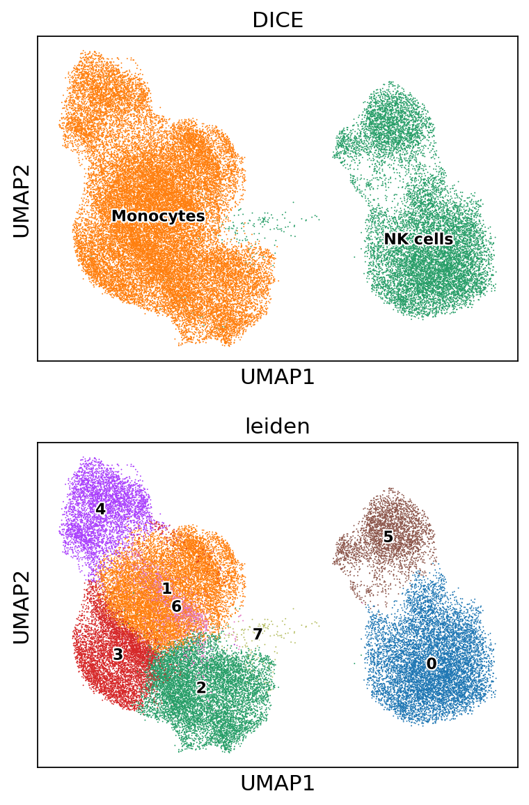
NK
Responding clusters: 0
Resistant clusters: 5,7
AML
Responding clusters: 1,3
Resistant clusters: 2,4

Slide 38
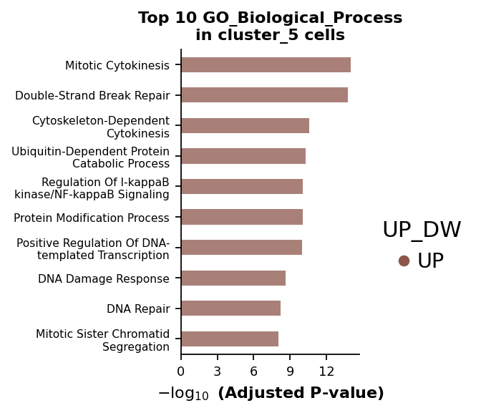






Slide 39





AML
Responding clusters: 1,3
Resistant clusters: 2,4

Slide 40






Slide 41




Slide 42




Slide 43



Slide 44




Slide 45



Slide 46



Slide 47


Slide 48


Slide 49


Slide 50
Summary
Current single cell data analysis covered NK and AML cells derived from pre and post injection into the mouse model
NK and AML cells formed separate clusters on UMAP spaces, which can be annotated by computational algorithm. Marker gene expression confirmed cell type identities
Fresh NK cells over-expressed genes involved in immune function, cell proliferation and metabolism pathways, while Blood NK and Bone marrow NK over expressed TNF-alpha signaling pathway
Fresh NK cells express higher activating receptors, degranulation marker LAMP1 and cytolytic molecule perforin1, whereas blood and bone marrow NK over expressed NK inhibitory receptors contributing NK cell exhaustion
On the other hand, Fresh AML tumor showed enriched activities in pathways associated with IFNA, JAK-STAT and TNFA, contributing to the sensitiveness to NK cell killing.
Blood and Bone marrow AML cells activated pathways in OXPHOS, Glycolysis, Myc and matabolism, which in return resulting in resistance to NK cytotoxicity
AML cells in general had high metabolic activities than NK cell does, reflecting NK cells lost fit for metabolism and may contribute to loss of tumor control efficacy in vivo
Future directions to analyze AML cells experienced NK vs NK naïve treatment conditions, to discover co-evolution mechanism between AML and NK cells and how does it lead to NK resistance

